Slide 1
ConnectBud
Java
Class 1
By: Rahul Joshi

Slide 2
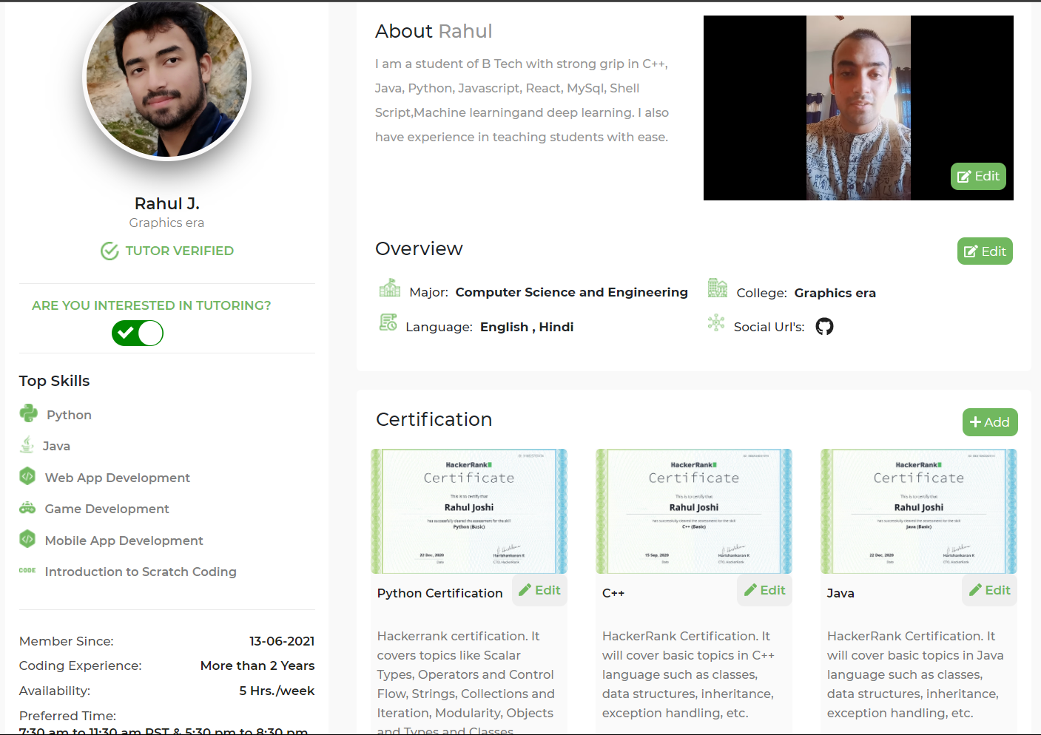

Slide 3
Course Overview
Class 1: • Introduction of Java
• Environment setup

Slide 4
Introduction
Python is a OOPs language.
Eg.
C used structural, python follows functional programming!
Python uses Compiler to compile and interpreter to run.
Compiler. It compiles whole code and then produces output.
Interpreter : It executes each line separately.
Guido van Rossom, 1989, released version 1991.

Slide 5
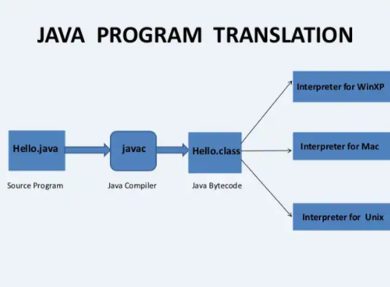

Slide 6
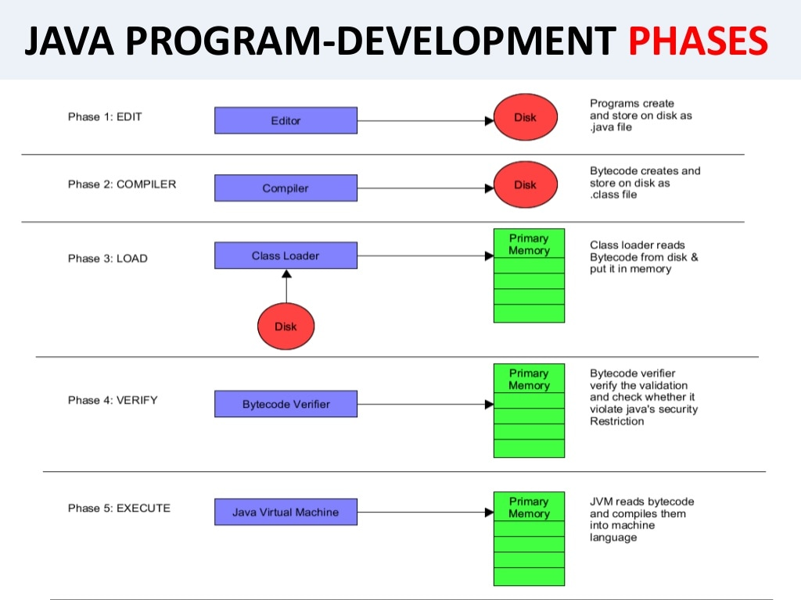

Slide 7
Commands
Pwd : path
Python –version : Check the version
cd : Change Directory
cd .. : return to parent folder
cd arav : go inside arav folder.
Mkdir : make directory(creating folders).
ls : list

Slide 8
End
For any queries: Contact:
Rahul Joshi rj26280218@gmail.com

